Slide 1


KAZSTORY
Kazakhstan’s history, explored — not memorized.
An interactive, map-based learning platform built with historians at Nazarbayev University.
Working prototype
NU faculty advisors
Seeking ₸3,000,000
Notes:
Open with the one-liner. KazStory turns Kazakh history into something students explore on a living map. Three facts up front: the prototype already works, NU historians are on board, and we are raising 3 million tenge to run the first pilot.

Slide 2




THE PROBLEM
History is taught as memorization — and students disengage.
Static formats
Textbooks and fragmented resources treat the past as names and dates to recite, not something to understand.
0
"They are terrible, and I would want to change everything."
— Zhakyslyk Sabitov, Head of the Scientific Institute for the Study of the Ulus of Juchi under Kazakhstan's Ministry of Science and Higher Education and author of over 300 academic publications
modern, interactive platforms exist for Kazakh history
Geography and time are invisible
Why events happened where and when they did is nearly impossible to convey through text alone.
The gap is in delivery, not knowledge — the scholarship exists; the format fails students.
Unequal access
Students outside major cities have the least access to engaging, high-quality historical learning (SDG 4 gap).
Notes:
Frame it as a delivery gap, not a knowledge gap. Kazakhstan's scholarship is strong; the formats are not. Geography and chronology are the two things text can't teach.

Slide 3
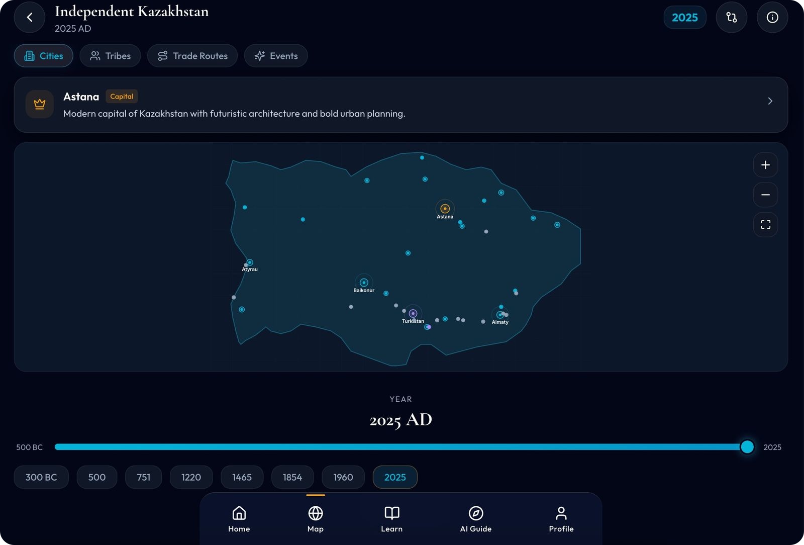



THE SOLUTION
A living map of Kazakh history.
Move through time
Drag the timeline from 500 BC to 2025 — watch borders shift, cities grow, and trade routes activate.
Built around the map
Figure profiles, city histories, event timelines, and a full cultural layer: music, cuisine, nomadic life.
Designed for retention
Quizzes, map challenges, points, and badges turn study into an active habit.
Actual product — the dynamic map, scrubbing the year 2025 AD.
Notes:
This is the core mechanic: history becomes spatial and visual. Everything else — figures, cities, culture, gamification — hangs off the map.

Slide 4
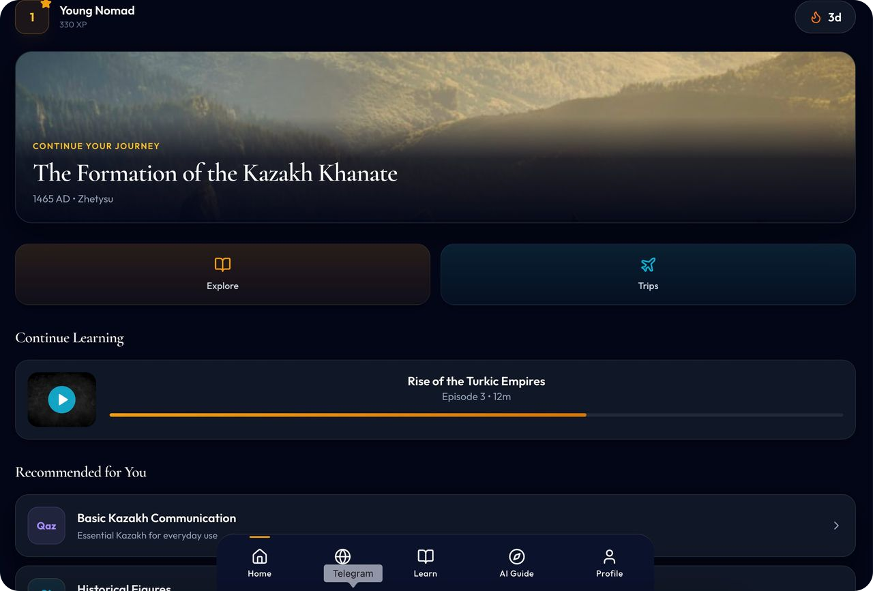
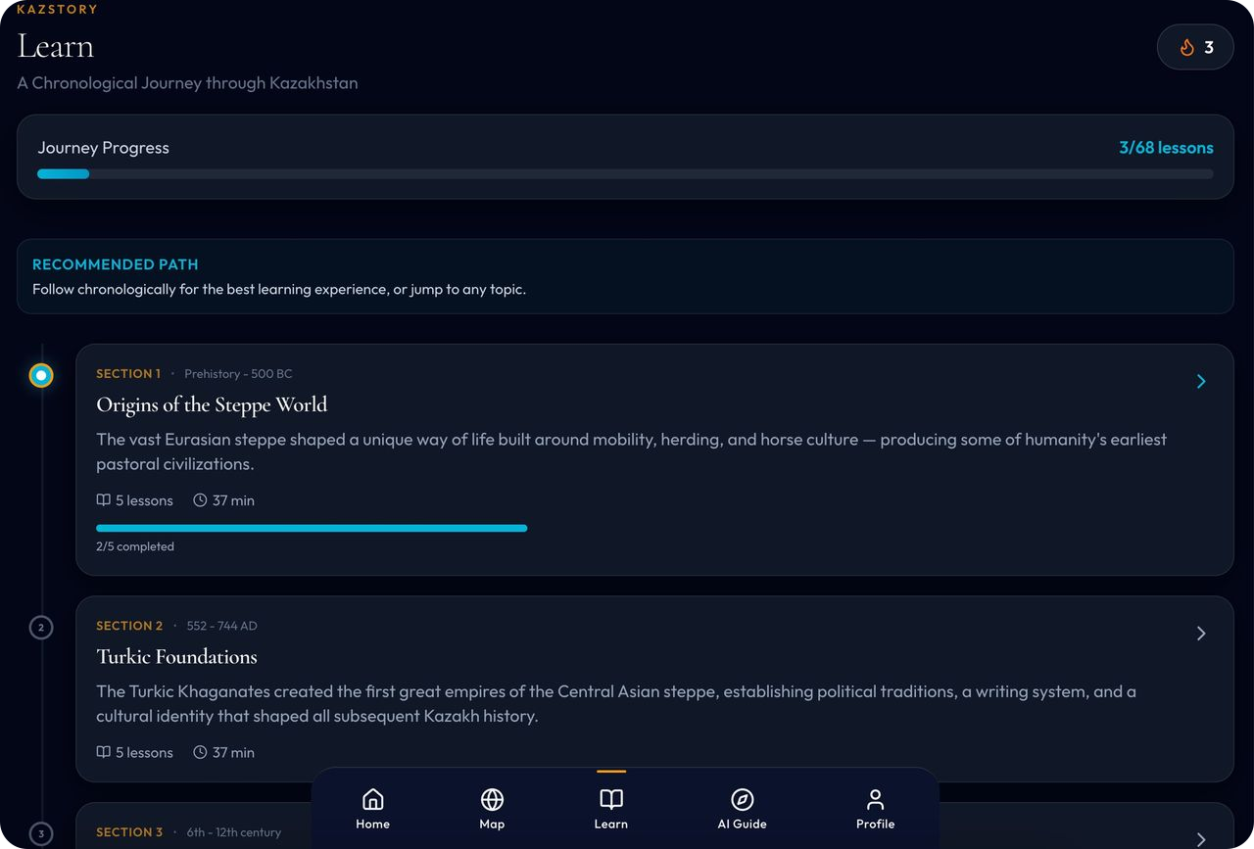
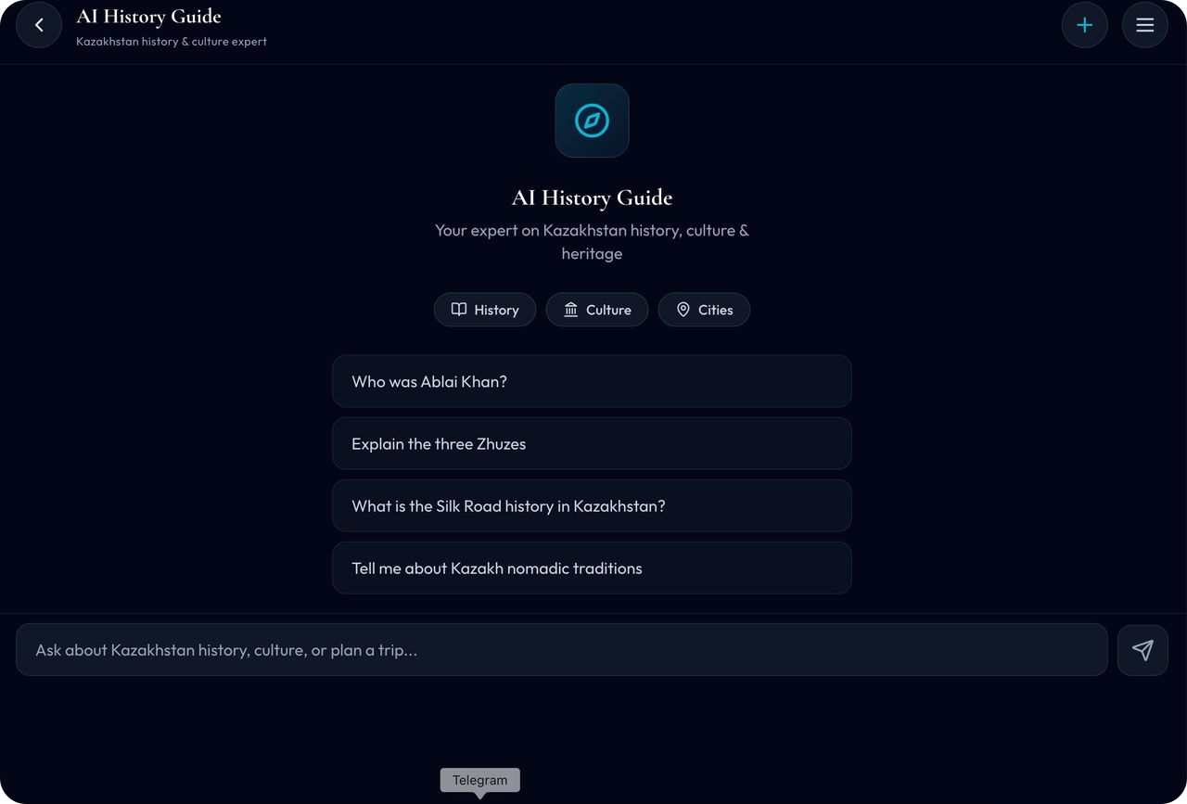
TRACTION · PRODUCT
Not a concept. A working prototype.
Built and functional today — map, lesson journeys, city deep-dives, gamified progress, and an AI history guide, in a dark steppe-blue and gold design language.
Learner home — journeys, streaks, XP
Chronological journey — 68 lessons by era
AI history guide — ask anything
Demo available on request.
Notes:
The single biggest de-risking fact: the product exists. Offer a live demo — the timeline scrub gets the strongest reaction.

Slide 5


WHY KAZSTORY WINS
Three things competitors can’t easily copy.
A true historical map
Scholarship built in
Engagement engineered
Time-scrubbing geography turns abstract facts into a visible, connected process — understanding that outlasts memorization.
Content drafted with PhD researchers and reviewed by NU faculty historians — produced in Kazakh, Russian, and English.
Quizzes, challenges, streaks, and badges — a tool students actually want to use converts knowledge into learning.
Notes:
The moat is the combination: a generic edtech app can add a quiz, but it cannot easily acquire scholar-authored Kazakh-history content or a real interactive historical map.

Slide 6
COMPETITIVE LANDSCAPE
No one combines all five.
Capability | Textbooks | Wikipedia | Quiz apps | KazStory
Interactive historical map | — | — | — | ✓
Deep Kazakh-history content | ✓ | ~ | — | ✓
Scholar-reviewed accuracy | ✓ | — | — | ✓
Curriculum-aligned learning | ✓ | — | — | ✓
Gamified engagement | — | — | ✓ | ✓
Kazakh · Russian · English | ~ | ✓ | ~ | ✓
✓ full · ~ partial · — absent
Notes:
Each alternative is strong on one axis. Textbooks are accurate but static. Wikipedia is broad and multilingual but unstructured. Quiz apps are engaging but content-agnostic. Only KazStory holds the full column.

Slide 7
MARKET
A national market, entered through one honest wedge.
7,000+
350,000+
3M+
schools in Kazakhstan
teachers
school-age students
Long-term addressable market — not a near-term target.
1 · PILOT
2 · FIRST SCHOOLS
3 · SCALE
~300 students
5–15 schools
National + Central Asia
→
→
Target site: Nazarbayev University (in discussion)
Several thousand students, years 2–3 post-pilot
Grows only as content, evidence, and team grow
Notes:
We are deliberately conservative: the 7,000-school figure is the long-term market, and the wedge is one pilot of about 300 students. NU is the target site and in discussion — not yet confirmed; if it falls through, we run the same pilot with a comparable institution.

Slide 8
BUSINESS MODEL
Freemium for equity. Licenses for revenue.
Free
Student Pro
Family
Schools & Universities
₸0
₸999
₸3,000
₸599,000
Core content · quizzes · map preview
/student · month — full map + advanced content
/month — up to 5 members
/1,000 students · month — classes + teacher tools
Government (B2G): custom, quote-based — a later, separately-paced stream (public procurement runs multi-year). Investor view: one regional agreement of ~50,000 students ≈ ₸30M/month at standard school rates.
Notes:
Free tier keeps the mission and the funnel; the interactive map is a paid feature. Early revenue comes from universities, private schools, and individuals — not from government procurement, which we treat as upside on a multi-year clock.

Slide 9



IMPACT · SDG 4
Quality education, made equitable.
Short term
Equity
Long term
Students build understanding, not recall — seeing why and where events happened. Teachers get a modern, trustworthy classroom tool.
Fully digital: the same scholar-grade content reaches regional and rural students as reaches Astana — narrowing the access gap.
A lasting public resource for heritage and identity — and a working model for turning scholarship into public knowledge.
Notes:
This is a Social Impact application: the free tier plus digital delivery is the equity mechanism, and the long-term effect is cultural — a public resource for how a country understands its own past.

Slide 10
ROADMAP · 24 MONTHS
Prove value first. Then earn the right to scale.
M 1–6
M 6–12
M 12–18
M 18–24+
Content & build
Pilot (~300 students)
Validation
First revenue
First scholar-grade content batch; prototype hardened to pilot-ready in KZ / RU / EN.
Target site: Nazarbayev University — in discussion. Engagement + learning data collected.
Iterate on classroom feedback; publish a validation report — the basis for scaling.
Institutional licenses + Student Pro; expand toward 5–15 schools.
Notes:
Deliberately staged: nothing scales until the pilot produces evidence. First revenue lands in months 18–24, led by institutions that can move fast — universities and private schools.

Slide 11





TEAM
A founder who has already built one.
Salamullah Saleh
Husnain Rasool
Development, PhD in computer science
Founder · product & development
Founder, Y-CHAP (US-incorporated 2026): clinician advisors from Harvard, Yale, Johns Hopkins, King’s College Hospital London & Mayo Clinic
$15,000+ raised · 3,000+ people reached through workshops & screenings
Medical student · Q1-journal published researcher · studied at Johns Hopkins, Yale & Rochester
Built the KazStory prototype shown in this deck
Salma M
Chief Project Strategist · published author
Timur Issakulov
Media — clients incl. BI Group, Huawei, NU
Sandal Popov
Raola Yerbolat
Business Manager, BBA
Business advisor
Notes:
The execution question, answered: the founder has already taken one venture from idea to a US-registered organization with elite clinical partners, real funding, and thousands reached — and the KazStory prototype is his second shipped product.

Slide 12

ACADEMIC FOUNDATION · NAZARBAYEV UNIVERSITY
The scholarship is the moat.
Dr. Daniel Beben
Dr. Daniel Scarborough
Diana Kopbayeva, PhD
Chair, History, Philosophy & Religious Studies
Professor of History · PhD, Georgetown
Instructor of History · nation-building scholar
Chief Academic Advisor
Senior Historical Advisor
Historical Content Advisor
The KazStory app has the potential to provide all citizens of Kazakhstan with unprecedented access to the history of their country. It can also increase global awareness of the history, literature, and traditions of the people of Kazakhstan.
— Dr. Daniel Scarborough, Senior Historical Advisor
Pipeline: PhD researchers draft → faculty review & correct → published in Kazakh, Russian & English.
Notes:
Not nominal endorsements — the faculty produce and validate content through a repeatable pipeline. The quote is on record from Dr. Scarborough.

Slide 13
THE ASK
₸3,000,000 — to turn a prototype into proof.
Content creation & review
₸1,050,000 · 35%
Platform development
₸900,000 · 30%
Pilot (~300 students)
₸600,000 · 20%
Technology & setup
₸300,000 · 10%
Contingency
₸150,000 · 5%
What it buys: the launch content batch, a pilot-ready product, and a validated pilot — the evidence base every later stage stands on.
Salamullah Saleh · Founder, KazStory · Astana, Kazakhstan
Notes:
Close on the use of funds: content-weighted by design, because content is both the product and the moat. End by inviting them into the live demo.

